Slide 1
Plagiarism
Understanding Types, Consequences, and Prevention Strategies

Slide 2
Introduction
Plagiarism is the act of presenting someone else's words, ideas, designs, or data as your own intentionally or unintentionally without giving proper credit.
Examples:
Copying a paragraph from Wikipedia
Using ChatGPT or AI to write your essay without disclosure
Using another student’s work or reusing your old one
Forgetting to cite a quote, chart, or theory
Think About It:
If someone used your Instagram post or artwork without tagging you, how would you feel?

Slide 3
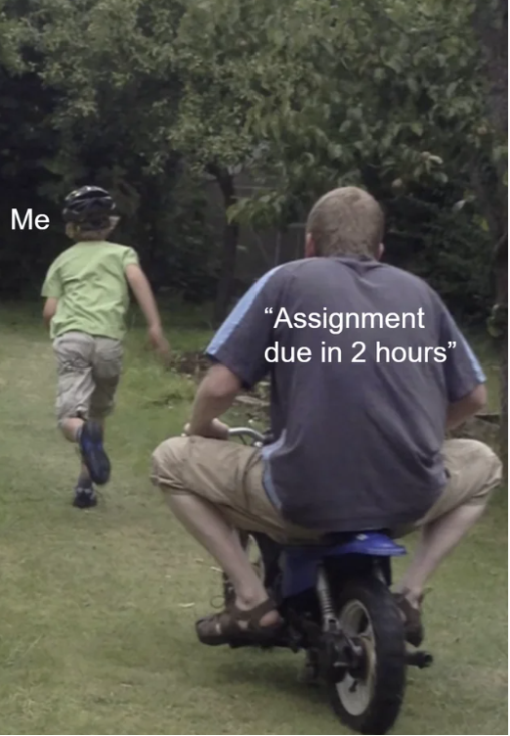
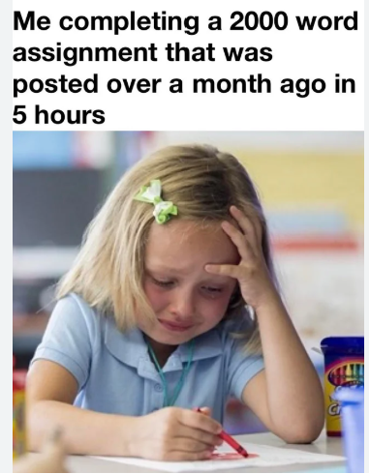
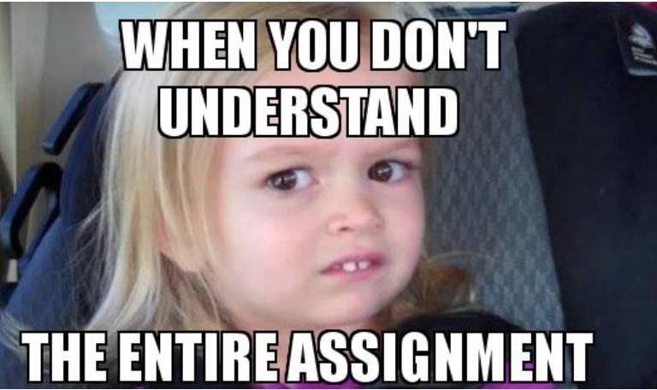
Why do student plagiarize?
Time Pressure: “It’s due in 2 hours!”
Fear of Low Grades: “I need an A.”
Unclear Guidelines: “I didn’t know I had to cite that.”
Lack of Understanding: “I changed some words — isn’t that enough?”
Procrastination: “I’ll just copy something quickly…

Slide 4
01
Types of Plagiarism

Slide 5
Global Plagiarism
What is it? When you take an entire paper, speech, or project from a single source and submit it as your own.
Examples:
Downloading an essay from a website
Paying someone to do your assignment
Copying your friend’s entire work
Copying from a book or internet without credit
Why it's wrong: This is like stealing someone’s full work and putting your name on it. It’s completely unethical.
Remember: If the whole work is not yours, it’s called global plagiarism (Lucas, 2001).

Slide 6
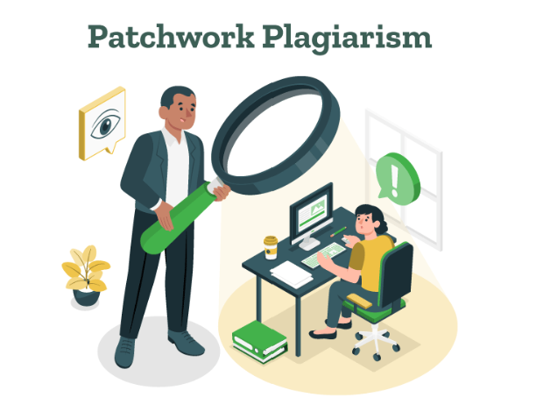
Patchwork Plagiarism
What is it? Mixing content from two or more sources and pretending it’s all your own without giving credit.
Example:
You copy one paragraph from Wikipedia
One from a blog
One from a YouTube script Then you glue them together as your “research.”
Why it’s wrong: Even if you change a few words, it’s still not your original idea and it’s not real writing.

Slide 7
Incremental Plagiarism
What is it?
Most of the work is yours but small pieces (quotes, facts, phrases) are taken from others without citation.
Example: You write your own speech but copy a few sentences or stats from online articles and forget to mention them.
Why it's serious:
Your teacher or audience doesn’t know what’s yours and what’s not and that’s misleading.
Remember:
Even a single sentence or idea from someone else must be properly credited (Lucas, 2001).

Slide 8
Summary of the types
Type of Plagiarism | What Happens | Example
Global | Entire project is copied from 1 source | Downloading an essay from a website
Patchwork | Copy-paste from multiple sources | Mixing parts from blogs, books, Wikipedia
Incremental | Small parts copied without credit | Adding a stat or quote without citation

Slide 9
02
Consequences

Slide 10
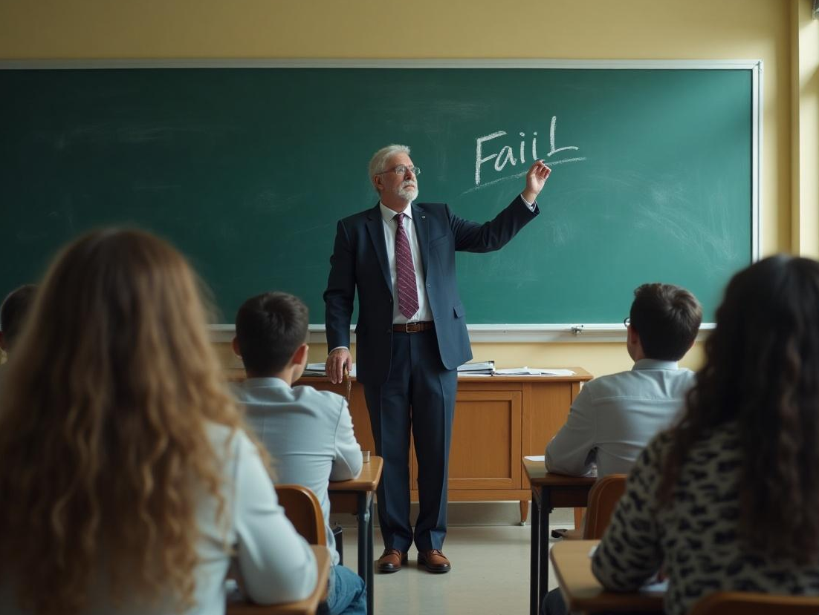
Academic Punishment
What happens if you plagiarize?
Failing the Assignment Your teacher may give you a zero on the task, no matter how much work you did.
Failing the Course In serious cases, your grade for the entire subject could be an “F”.
Academic Suspension Repeated plagiarism may lead to suspension or being put on academic watch.
Expulsion Some schools and universities have a zero-tolerance policy and may expel students.
Permanent Record Damage A note about plagiarism might be added to your student file, affecting scholarships or future admissions.

Slide 11
Legal Repercussions
Plagiarism can be illegal in the real world, not just in University.
Copyright Violation Copying from books, songs, films, or software without permission can break copyright laws.
Fines or Financial Penalties If taken to court, you might have to pay large fines or damages to the original creator.
Legal Action Some authors or companies take legal action for plagiarism, and the cases can be very public.
Cancellation of Degrees or Certifications If plagiarism is discovered after graduation, your degree or professional license (e.g., medical or legal) could be taken away

Slide 12
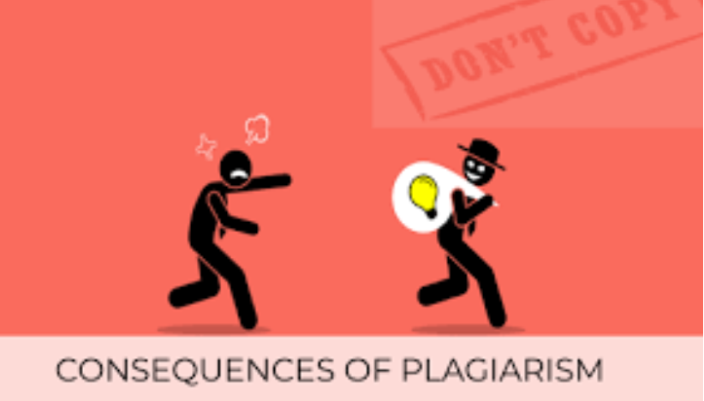
Personal Consequences
Plagiarism also hurts you personally.
Lack of Learning If you copy other’s work, you miss the chance to grow your skills and knowledge.
Guilt and Shame Knowing you cheated can cause stress, anxiety, and self-doubt.
Low Confidence If you rely on copying, you may feel you’re not good enough to create your own work.
No Pride in Your Work It's hard to feel proud of something that isn’t truly yours.

Slide 13

Damage to Reputation
Plagiarism hurts your good name and character.
Teachers may stop seeing you as an honest student.
Employers and professionals may not trust your work.
Once your reputation is damaged, it is very hard to fix.
People may talk about your plagiarism, and that can follow you for a long time — even online.

Slide 14
03
How to prevent Plagiarism

Slide 15
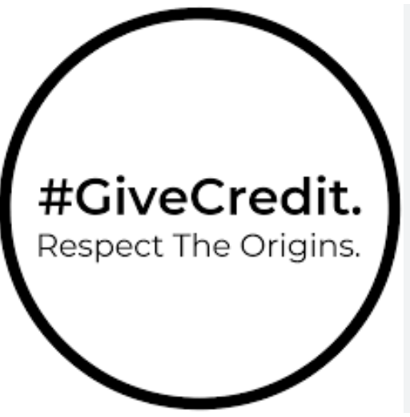
Give Credit to the Author
Always mention the name of the person or group whose words or ideas you are using.
This includes:
Direct quotes (using exact words)
Paraphrased ideas (your own words but their idea)
Statistics and facts
Unique or new information
Giving credit shows honesty and builds your own credibility.

Slide 16
Use in-text Citations
Use In-Text Citations (APA Style)
In-text citations tell your reader where the info comes from.
APA Style includes:
Author’s last name
Year of publication
And sometimes page or paragraph number
Example:
“Television affects how people view the world” (Gerbner et al., 1994, p. 20).

Slide 17
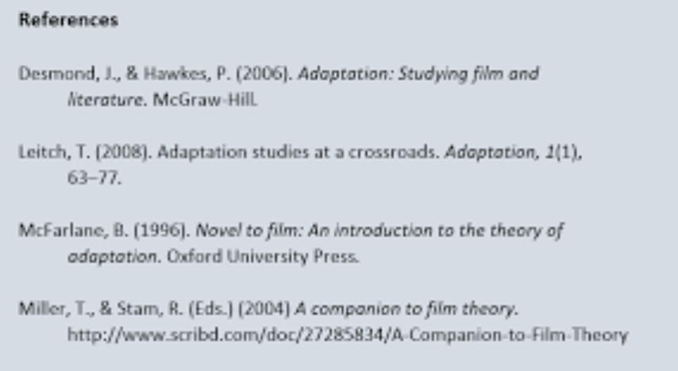
Reference List
At the end of your paper, make a Reference List.
It includes:
Author(s)
Title
Year
Publisher
Page number (if needed)
Website info (not just a URL)
How it helps:
It allows readers find your sources if they want more info.
Proper referencing proves that you have done your homework and respected intellectual property.

Slide 18
Use Online Resources
Many websites and tools are available to help you avoid plagiarism and improve your academic honesty. These platforms offer:
🔹 Articles – Easy-to-read explanations of what plagiarism is and how to avoid it. 🔹 Video Guides – Step-by-step tutorials on citing sources and paraphrasing correctly. 🔹 Interactive Courses – Free or paid modules that teach you how to reference in APA, MLA, and other formats.
Popular Resources:
YouTube Channels like Scribbr and Academic Skills.
Coursera & edX – Offer short courses on academic integrity.
Turnitin and Grammarly – Help detect plagiarism and improve your writing

Slide 19
Guidelines for Writing Plagiarism free
Acknowledge All Sources Always cite any ideas, data, or words that are not your own using the appropriate citation style (e.g., APA, MLA, Chicago).
Paraphrase Properly Don’t just change a few words. Rewrite ideas in your own voice and include a citation to the original source.
Avoid Patchwriting Mixing copied and original text is still plagiarism. Rewrite fully and clearly give credit to the original author.
Do Not Recycle Assignments Submitting the same paper for multiple courses without permission is unethical. Always create fresh content.
Maintain Accuracy Present information truthfully don’t invent sources, data, or misrepresent other’s work.

Slide 20
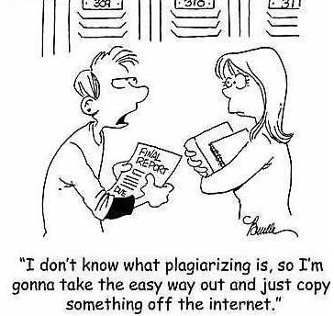
Conclusion
Plagiarism means using someone else’s work and pretending it’s your own. To avoid it, learn how to give credit, write in your own words, and manage your time well. Doing your own work helps you learn better and stay out of trouble. Remember, your ideas are important—don’t be afraid to use them! Be honest, be proud, and let your work show who you really are.

Slide 21

Thank You!

